Slide 1
YONGA SETLERİ (CHIPSETS)

Slide 2
YONGA SETLERİ
Anakart yonga setleri Kuzey ve Güney Köprüsü adı verilen iki adet yongadan oluşur.
Kuzey Köprüsü CPU, sistem ana belleği ve grafik alt sistemi arasında bir köprü vazifesi görür ve yine kendi üzerinden Güney köprüsünün yukarıda bahsedilen bileşenlerle bağlantısını sağlar. Bu yüzden ana sistem performansı üzerinde çok büyük etkisi vardır.
Güney Köprüsü ise IDE aygıtların, floppy sürücülerin, USB, PCI, PS/2 ve seri portların yönetimini üstlenir.

Slide 3
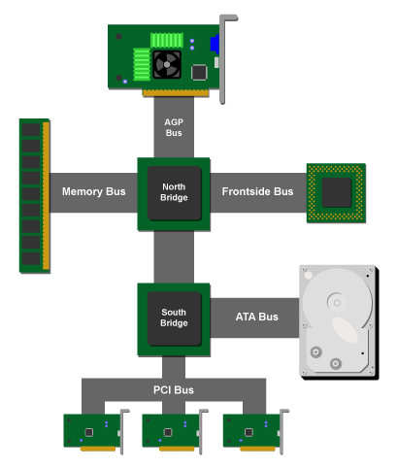
YONGA SETLERİ

Slide 4
Chipset Üreticileri ve Ürünleri Listesi:
Intel chipset product list.
VIA chipset product list.
SiS chipset product list.
ATI chipset product list.
NVIDIA chipset product list.
ULi chipset product list - purchased by NVIDIA

Slide 5
Intel Firmasının Ürün Listesi
Desktop chipsets
  Performance desktop chipsets
  Mainstream desktop chipsets
  Value desktop chipsets
Server and workstation chipsets
  Intel® Server chipsets
  Intel® Workstation chipsets
Notebook chipsets
  Performance notebook chipsets
  Mainstream notebook chipsets
  Value notebook chipsets
Embedded chipsets
  Performance embedded chipsets
  Scalable embedded chipsets
  Low power embedded chipsets
  Legacy embedded chipsets

Slide 6
Intel Firmasının Masaüstü Yonga Setleri
Performance Desktop Chipsetsback to top
  Intel® X38 Express Chipset
  Intel® 975X Express Chipset
  Intel® 955X Express Chipset
  Intel® 925XE Express Chipset
  Intel® 925X Express Chipset
Value Desktop Chipsetsback to top
  Intel® 910GL Express Chipset
  Intel® 848P Chipset
  Intel® 845 Chipset
  Intel® 845E Chipset
  Intel® 845G Chipset
  Intel® 845GE Chipset
  Intel® 845GL Chipset
  Intel® 845GV Chipset
  Intel® 845PE Chipset

Slide 7
Intel Firmasının Masaüstü Yonga Setleri
Mainstream Desktop Chipsets
  Intel® G35 Express Chipset
  Intel® Q35 and Q33 Express Chipsets
  Intel® P35 Express Chipset
  Intel® P31 Express Chipset
  Intel® G33 Express Chipset
  Intel® G31 Express Chipset
  Intel® Q965 Express Chipset
  Intel® Q963 Express Chipset
  Intel® G965 Express Chipset
  Intel® P965 Express Chipset
  Intel® 946PL Express Chipset
  Intel® 946GZ Express Chipset
  Intel® 945G Express Chipset
  Intel® 945P Express Chipset
  Intel® 945PL Express Chipset
  Intel® 945GT Express Chipset
  Intel® 945GC Express Chipset
  Intel® 945GZ Express Chipset
  Intel® 915G Express Chipset
  Intel® 915GV Express Chipset
  Intel® 915GL Express Chipset
  Intel® 915PL Express Chipset
  Intel® 915P Express Chipset
  Intel® 875P Chipset
  Intel® 865G Chipset
  Intel® 865GV Chipset
  Intel® 865P Chipset
  Intel® 865PE Chipset

Slide 8
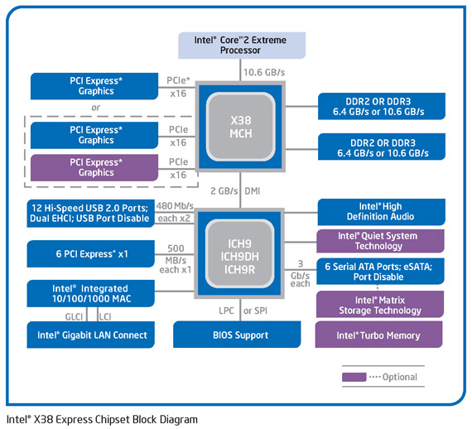

Slide 9
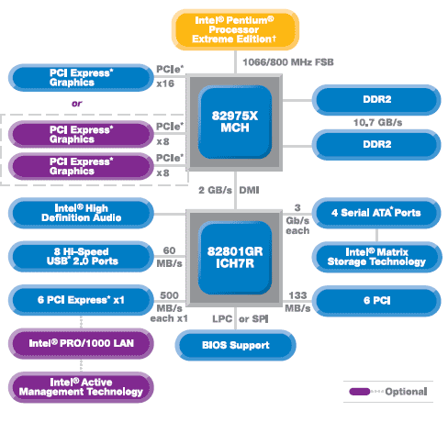

Slide 10
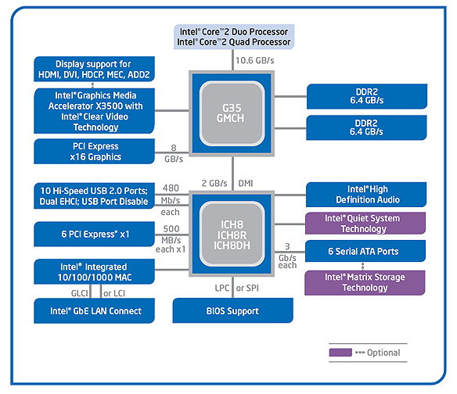

Slide 11
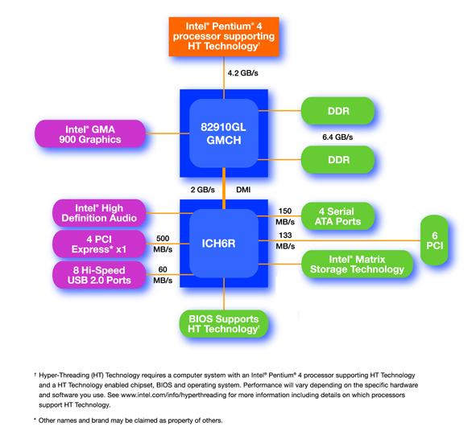

Slide 12
Server and workstation chipsets
Model | İşlemci Sayısı | İşlemciler | Sistem Veri Yolu
Intel® 3000 Chipset | 1 | Quad-Core Intel® Xeon® processor 3000Δ series Dual-Core Intel® Xeon® processor 3000Δ series | 1066/800/533 MHz
Intel® 3010 Chipset | 1 | Quad-Core Intel® Xeon® processor 3000Δ series Dual-Core Intel® Xeon® processor 3000Δ series | 1066/800/533 MHz
Intel® 3200 Chipset | 1 | Quad-Core Intel® Xeon® processor 3000Δ series Dual-Core Intel® Xeon® processor 3000Δ series | 1333/1066/800 MHz
Intel® 3210 Chipset | 1 | Quad-Core Intel® Xeon® processor 3000Δ series Dual-Core Intel® Xeon® processor 3000Δ series | 1333/1066/800 MHz
Intel® 5000P Chipset | 1-2 | Quad-Core Intel® Xeon® processor 5000 series Dual-core Intel® Xeon® processors 5000Δ series | 1066/1333 MHz
Intel® 5000V Chipset | 1-2 | Quad-Core Intel® Xeon® processor 5000 series Dual-core Intel Xeon processors 5000Δ series | 1066/1333 MHz
Intel® 5100 Memory Controller Hub Chipset | 1-2 | Quad-Core Intel® Xeon® processor 5000Δ series Dual-Core Intel® Xeon® processor 5000Δ series | 1066/1333 MHz
Intel® 7300 Chipset | 4 | Quad-Core Intel® Xeon® processors 7300Δ series | 1066/MHz
Intel® E7210 Chipset | 1 | Intel Pentium 4 processor | 800/533 MHz
Intel® E7221 Chipset | 1 | Intel Pentium 4 processor supporting Hyper-Threading Technology† | 800/533 MHz

Slide 13
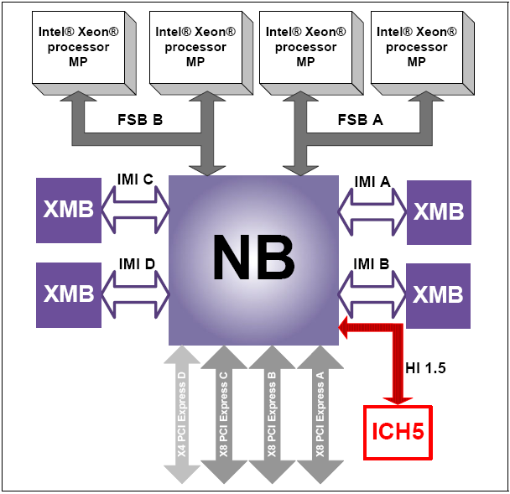
Intel® E8501 Chipset North Bridge (NB)

Slide 14
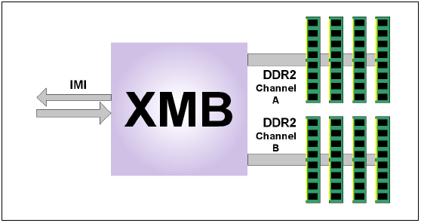
Intel® E8501 Chipset eXternal Memory Bridge (XMB)

Slide 15
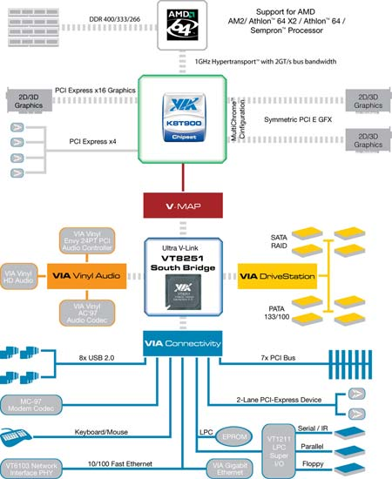
VIA K8T900

